Slide 1
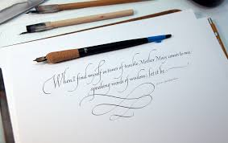
John Stevens : Calligrapher
Student's Name
Institutional Affiliation
Course Name and Number
Instructor's Name
Due Date

Slide 2
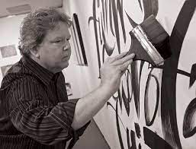
John Stevens
John Stevens is considered one of the unique letter artists globally, well-known for his talents as a designer, calligrapher, and letter artist.
Stevens works have graced magazines, book jackets, museums, magazines, libraries, and places of worship.
Every portion of John's work is hand-drawn on paper with no digital hacks used. John is therefore recognized as a Hand-Lettering Artist with global status for artwork.

Slide 3
Besides the use of graphics application in his work, Steven practices calligraphy as a form of art, making one-of-a-kind custom-built work incorporated in several private and public collections across the world.
He also works with well-known clienteles in book and magazine publishing, graphic design, packaging, type design, and film and television.
He has held numerous solo displays and has contributed to numerous group exhibitions worldwide and the most recently held in Belgium and Japan.
Steven has also obtained many invitations to teach at numerous national and international letter arts conferences across South American, United States, Europe, and Japan.

Slide 4
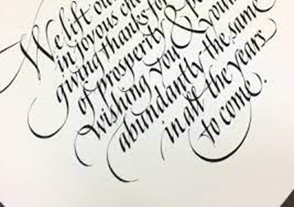
The wide range of exemplary work made him well renowned for his adaptability and skill as a letter artist and calligrapher.
Steven started as a sign painter in New York, but his limitless analysis of letters and their design directed him into kind, lettering, and calligraphy.
Steven has learned how to use several brushes, pens, and more advanced graphics using a computer.
Steven works with nationally recognized clients in advertising, publishing, packaging, film, and television.

Slide 5
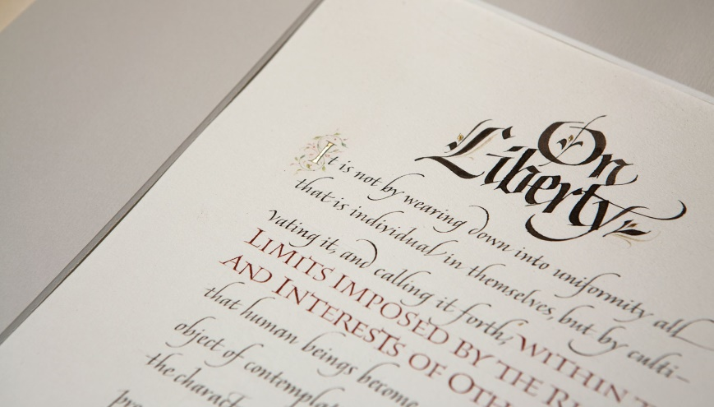
Steven's calligraphy shows how the artistic styles have evolved over the centuries through his exemplary work.
Worth noting is that the sweeping blow of the pen and the brush power leaves the character of the artiste on the words: abounding off point; a multi-sensual line and shape in space.
In his Calligraphy artworks, Steven employs the use of the best paper and ink, rousing the written term to the level of any supplementary art form(Zhao et al.,2020).
Some of Steven fabulous writing fonts from his Instagram page

Slide 6
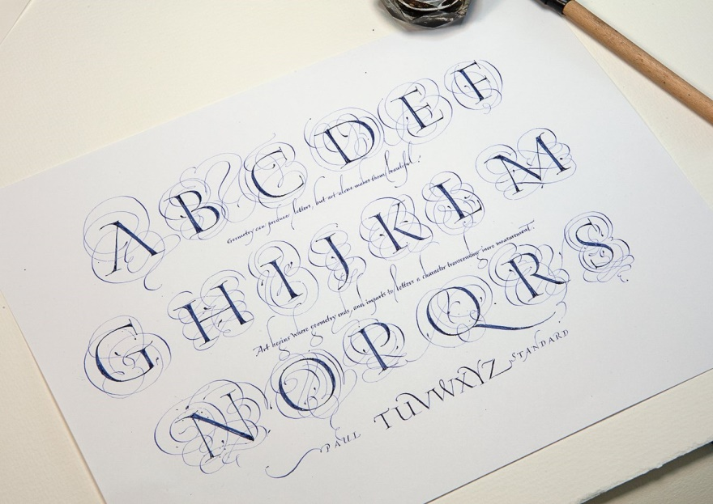
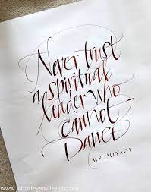
Some of Steven fabulous writing fonts from his Instagram page

Slide 7
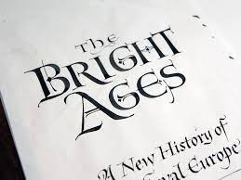
References
Zhao, B., Tao, J., Yang, M., Tian, Z., Fan, C., & Bai, Y. (2020). Deep imitator: handwriting calligraphy imitation via deep attention networks. Pattern Recognition, 104, 107080.

